Slide 1


Git Branching

Slide 2

Agenda
Git Branching: Pulling and pushing to a remote
Keeping the remote updated
Fetching and Merging commits from the remote
Pushing local commits
Using different branches

Slide 3
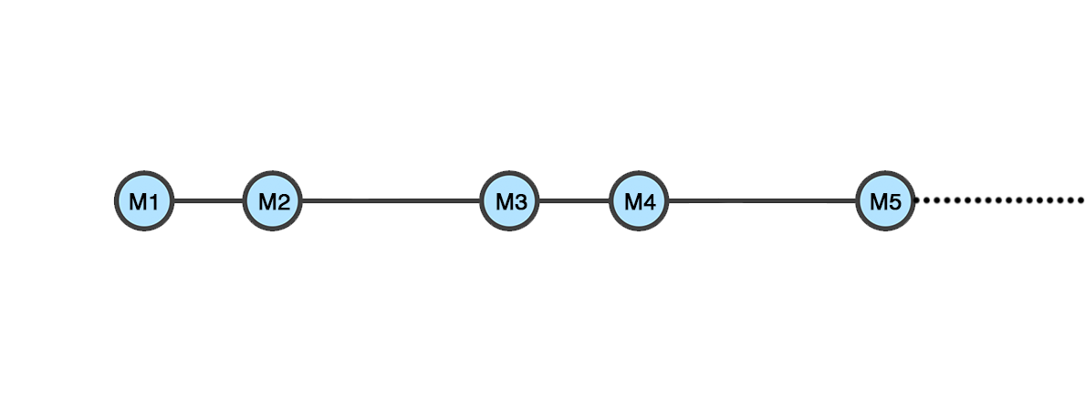
GIT: Keeping a remote updated
When working with GIT, you are working with a sequence of commits. Every time you create a commit, GIT stores the modifications their order, and the result of how our project look is the sequence of those commits.
main (local)
In this graph, we have a simple sucesion of commits, done in a linear way.
Afterwards commit M5 there is still work that has been done but hasn’t been committed yet.

Slide 4
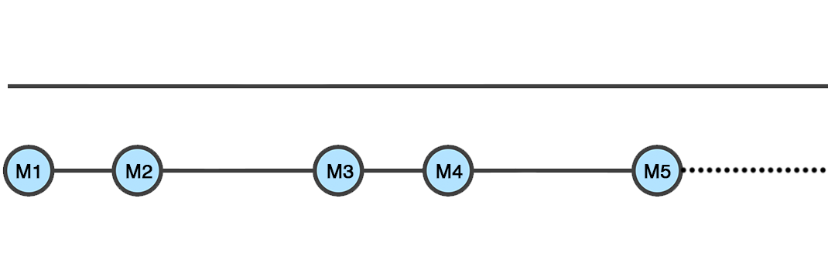
GIT: Keeping a remote updated
Let’s say we have been working only locally.
And we want to put our work in a remote.
We create our remote repository (signing into Github and creating it empty without any file)
We link it to our local project (git remote add origin <url>)
It would look empty, like this:
main (remote: origin)
main (local)

Slide 5
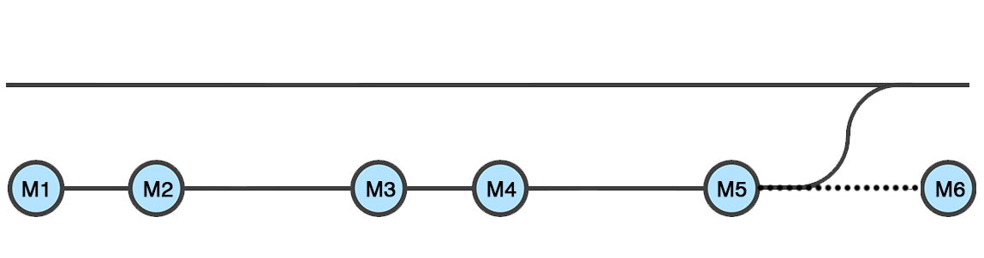
GIT: Keeping a remote updated
To put our changes in the origin main, we will need to push them.
Standing on our main local, if we do:
git push origin main
We will be putting those commits in the remote:
main (remote: origin)
push
main (local)
So, right now, until main (local) does another commit, both branches are updated one with the other.

Slide 6
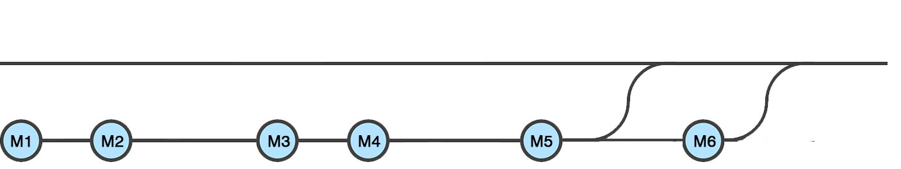
GIT: Keeping a remote updated
What happens if you keep on working?
Well, you just need to repeat the process:
main (remote: origin)
push
push
main (local)
So, right now, until main (local) does another commit, both branches are updated one with the other.

Slide 7
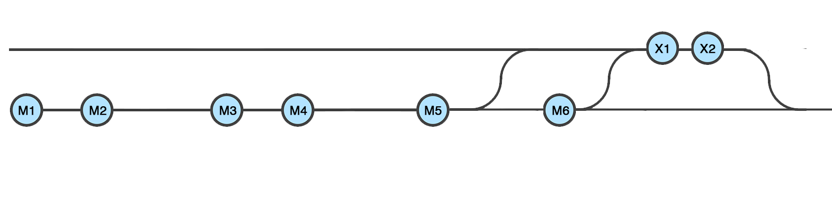
GIT: Keeping a remote updated
What happens if origin/main contains commits that you don’t?
You will need to pull them:
git pull origin main
main (remote: origin)
pull
push
push
main (local)
So, right now, until main (local) does another commit, both branches are updated one with the other.

Slide 8
GIT: Keeping a remote updated
Now, where did X1 and X2 come from if you don’t have them locally?
Could be:
Someone else must have pushed it to origin/main.
Maybe they were pushed and erased from the local
Fact is, it exists on origin/main but not in local/main, so we need to pull them
main (remote: origin)
pull
push
push
main (local)

Slide 9
GIT: Keeping a remote updated
What would happen if X1 and X2 exist on origin/main, but not locally, and I kept on working (commit M7)
main (remote: origin)
pull
push
push
main (local)

Slide 10
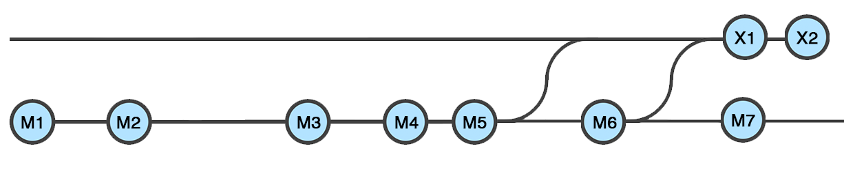
GIT: Keeping a remote updated
What would happen if:
X1 and X2 exist on origin/main, but not locally
The local main kept on moving forward and has a commit that the main in
the remote doesn’t?
main (remote: origin)
main (local)
This is branching. X1 and M7 have the same ancestor, yet they are different commits living in different branches (for now).

Slide 11
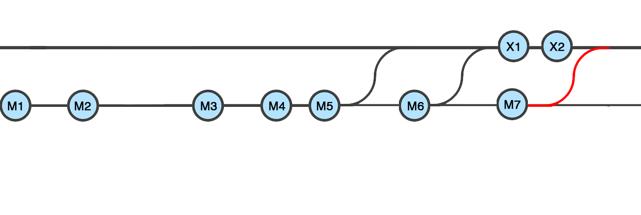
GIT: Keeping a remote updated
Git won’t let us push M7 to the main, because origin/main also moved forward and we are missing those changes in our branch.
main (remote: origin)
main (local)
M7 won’t be allowed to be pushed to origin/main because the latest commit in origin/main (X2) is not an ancestor of M7

Slide 12
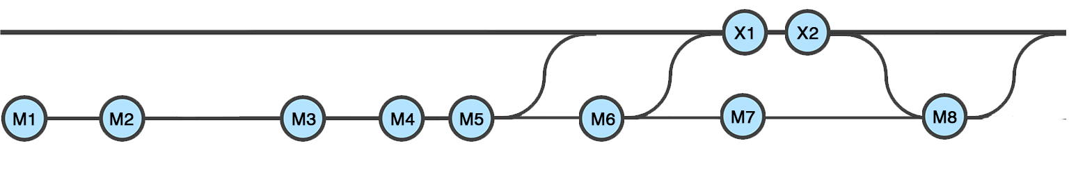
GIT: Keeping a remote updated
So, in order to push M7, wWe will need to pull X1 and X2 first to the local/main
Solve conflicts if necessary
Commit again (M8)
And then push
M8 will be allowed to be pushed to origin/main because at least one of its ancestors (X2 and M7) exists there.
main (remote: origin)
main (local)

Slide 13
GIT: Keeping a remote updated
What happened here? At some point, the history diverged. From M6 were created 2 different commits that might contain different information.
On the commit M8 both branches were unified again.
main (remote: origin)
pull
push
main (local)
Solve conflicts
Commit

Slide 14
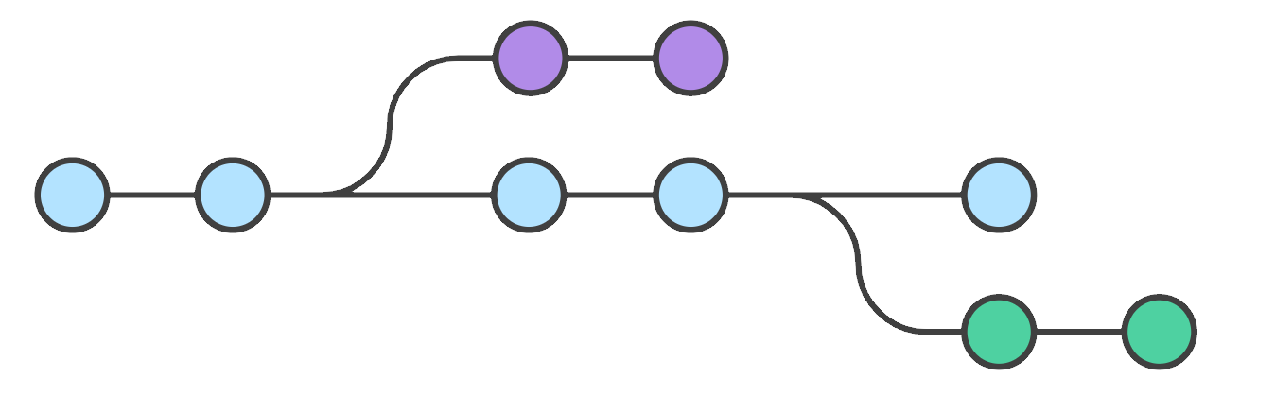
GIT branching
From Git documentation:
‘Branching means you diverge from the main line of development and continue to do work without messing with that main line’
feature1
main
feature2
In this graph, given a main branch:
Afterwards the second commit, it diverged and the branch ‘feature1’ was created
Afterwards the fourth commit, it diverged and the branch ‘feature2’ was created

Slide 15
GIT branching
Main contains 5 commits: M1, M2, M3, M4, M5
Feature 1 contains 4 commits: M1, M2, F1A, F1B
Feature 2 contains 6 commits: M1, M2, M3, M4, F2A, F2B
feature1
F1A
F1B
main
M1
M2
M3
M4
M5
F2A
F2B
feature2

Slide 16
GIT branching
The developer working in feature1 can work without interfering with everybody else’s code, and same way back and forth.
When you are working on a diverged branch, you need to constantly be sure that you are updated with the main one, by pulling those commits that you might not have.
feature1
F1A
F1B
main
M1
M2
M3
M4
M5
F2A
F2B
feature2

Slide 17
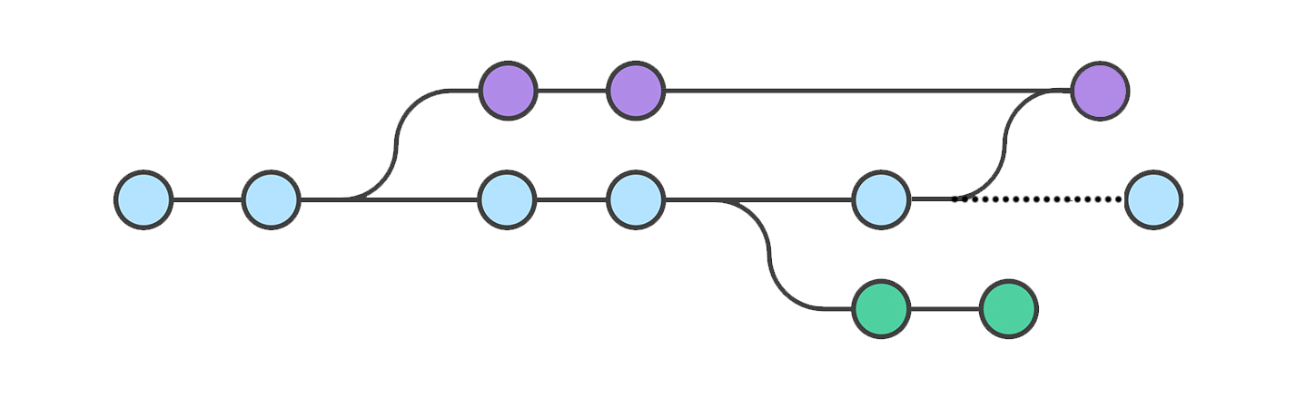
GIT branching
Standing on feature1 To bring those changes from main to feature1, we will need to pull from main.
git pull will bring all those commits that they are not in feature1: M3, M4, M5.
We might need to solve conflicts.
After solving them, we will be able to create a new commit F1C
F1C will have as ancestors 2 commits: F1B and M5.
feature1 will be updated regarding the main branch and 1 commit ahead.
feature1
git pull origin main
F1A
F1B
F1C
main
M1
M2
M3
M4
M5
M6
F2A
F2B
feature2

Slide 18
GIT branching
How to bring those changes?
git checkout feature1 // to make sure we are on the right branch
git pull origin main // bringing the commits
<solve conflicts>
git add .
git commit -m “Merging from main” // creating commit F1C
git pull origin main
feature1
F1A
F1B
F1C
main
M1
M2
M3
M4
M5
M6
F2A
F2B
feature2

Slide 19
GIT branching
Pulling doesn’t copy commits. It adds them to the branch. The commits are still the same. When you pull, this is what happens:
feature1
F1A
F1B
F1C
main
M1
M2
M3
M4
M5
M6
F2A
F2B
feature2

Slide 20
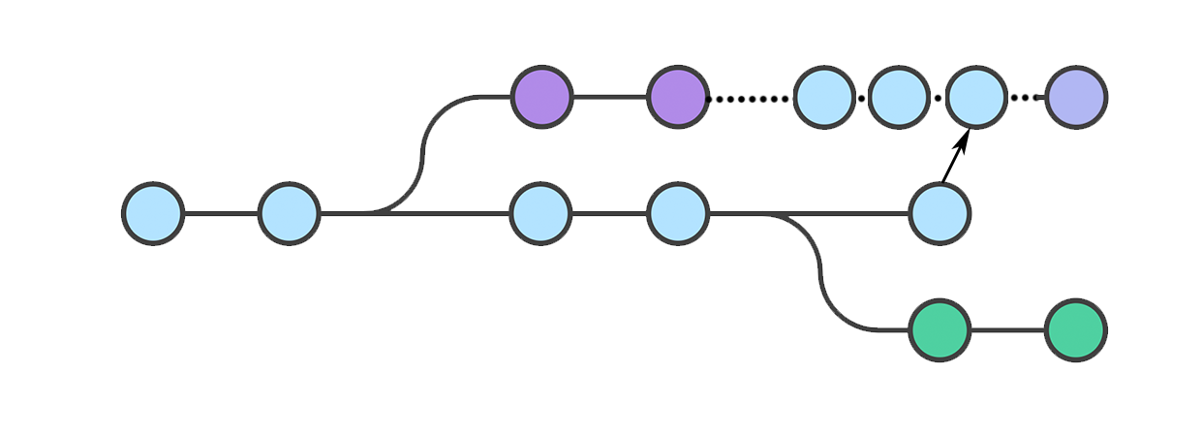
GIT branching
And NOT this:
feature1
F1A
F1B
M3
M4
M5
F1C
main
M1
M2
M3
M4
M5
F2A
F2B
feature2
Pulling and pushing commits is not about copying those commits, but to adding them to the branch tree.

Slide 21
GIT: keeping the main updated
When working on a team, the more you pull, the smaller conflicts you will need to solve. So pull often and solve often smaller parts, rather than doing it once and solving many conflicts.
Before pushing to the main, you need to be sure that you are updated regarding it (git won’t let you do it otherwise)
feature1
F1A
F1B
F1C
main
M1
M2
M3
M4
M5
M6
F2A
F2B
feature2

